Slide 1
Introduction to Artificial Intelligence
Why , What, How, Where

Slide 2
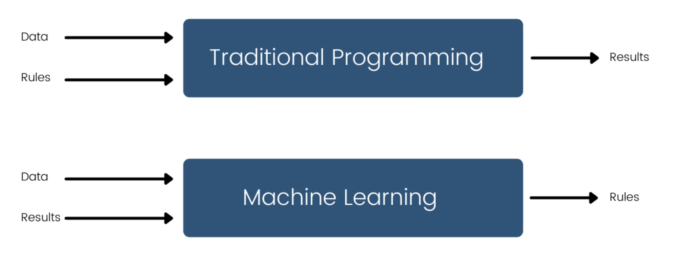
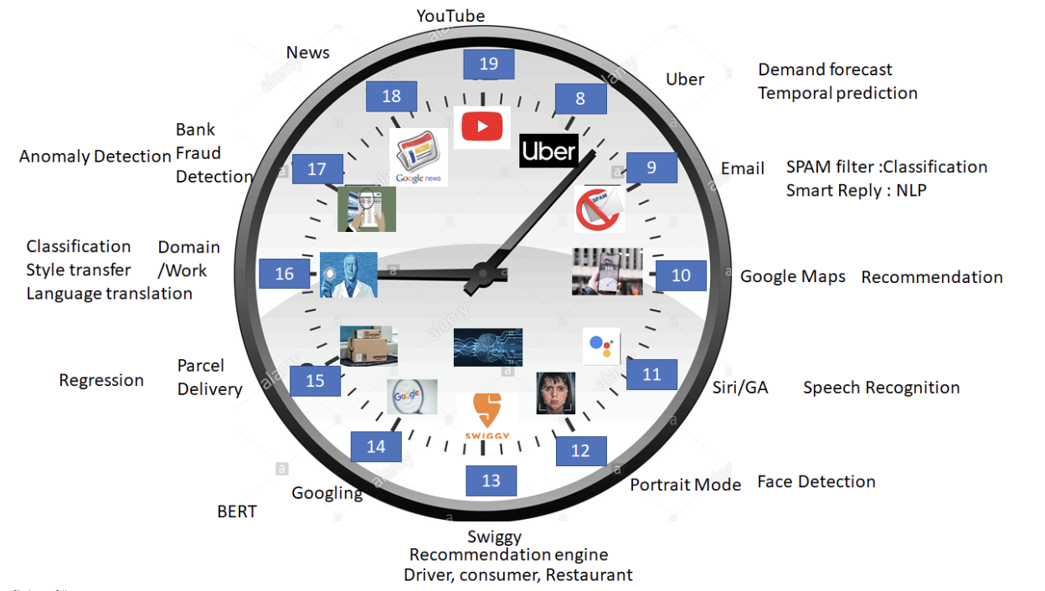
Why :
Automate the task
Improve efficiency
Solve complex problem
Why AI

Slide 3
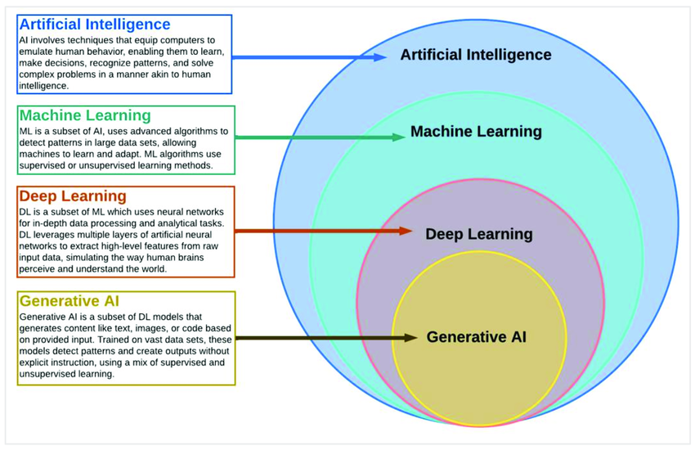
What is AI: "AI is the ability of a machine to mimic intelligent human behavior."
Intelligence is the ability to acquire knowledge, understand, reason, solve problems, adapt to new situations, and make decisions.

Slide 4
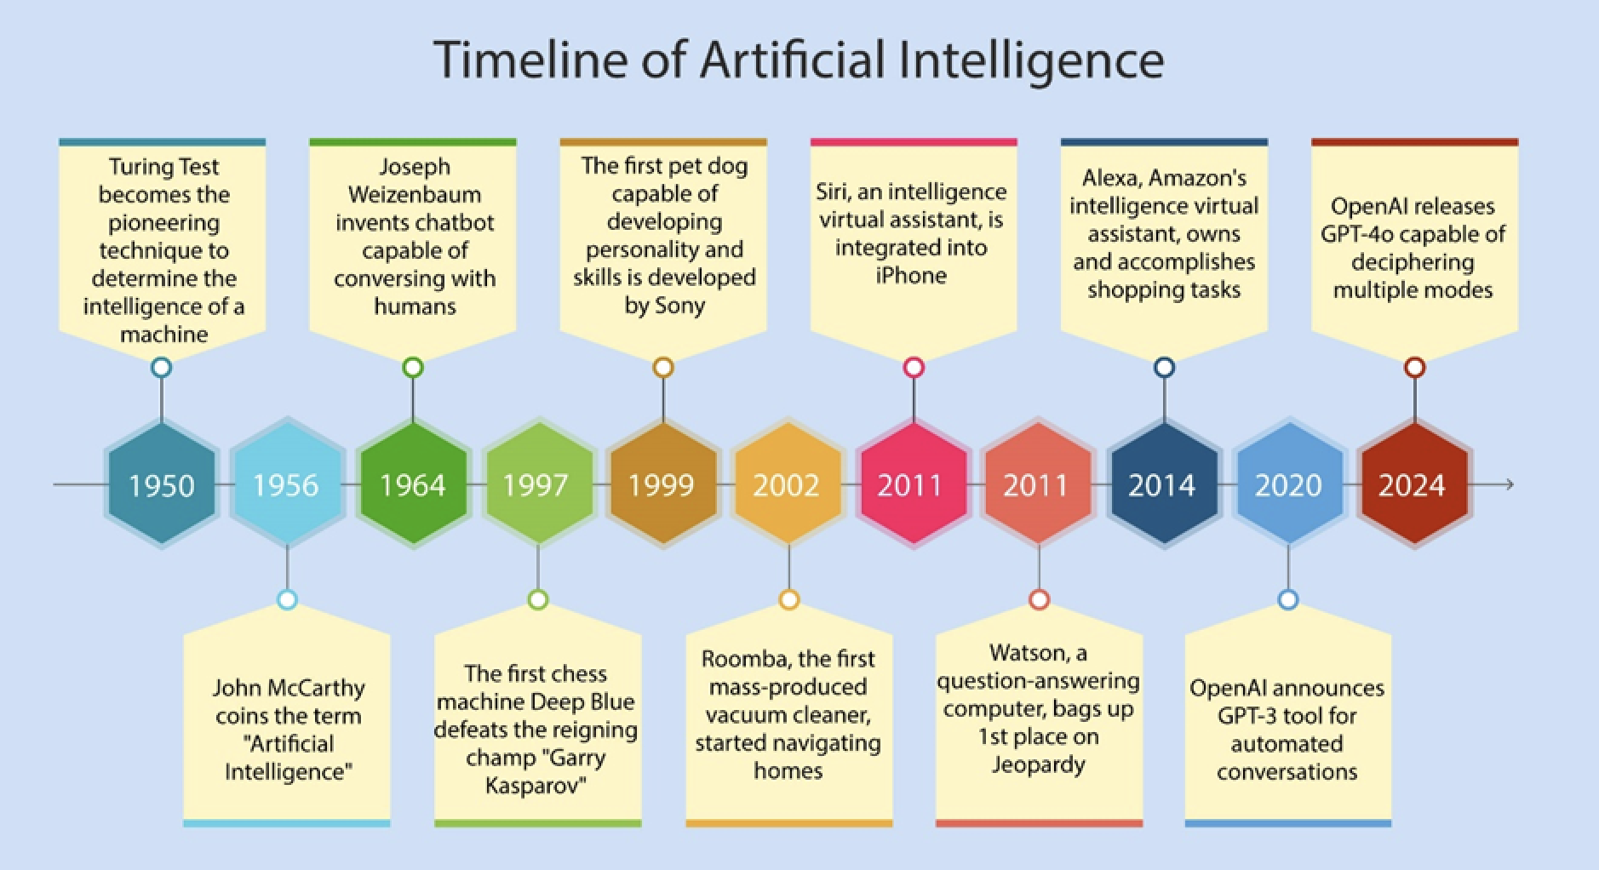

Slide 5
1936 – Alan Turing
1943 – McCulloch & Pitts
1950 – Turing Test
1956 – Dartmouth Conference
1959- ML - Arthur Samuel
1970-80- 1st winter
1980-1990- expert system, knowledge base
1986: Backpropagation
1990-1997- 2nd winter
1997- deep blue defeats Garry Kasparov
2006 – Deep Learning coined (Geoffrey Hinton)
2020- GPT

Slide 6
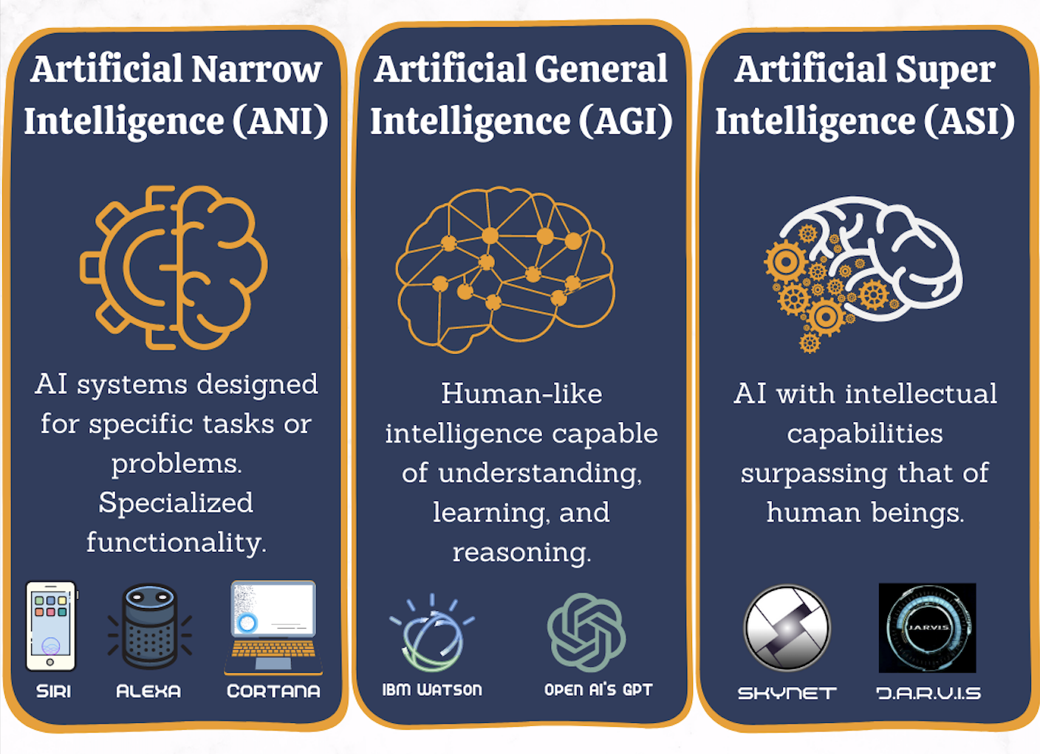
Ongoing

Slide 7
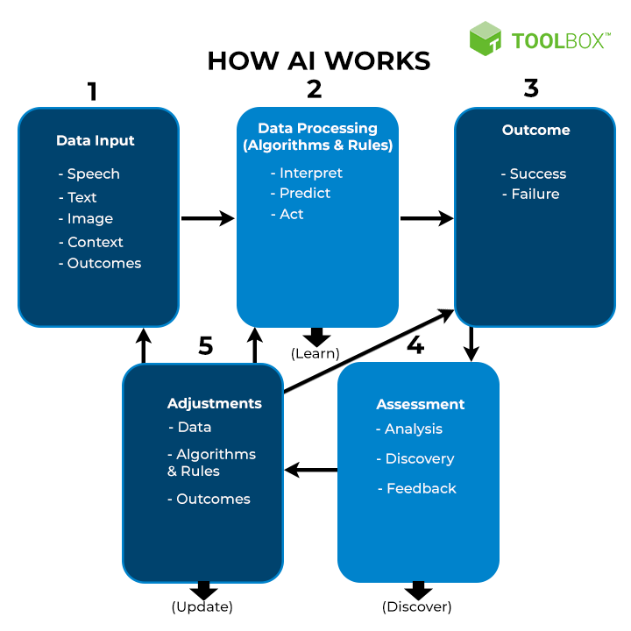
How AI:

Slide 8
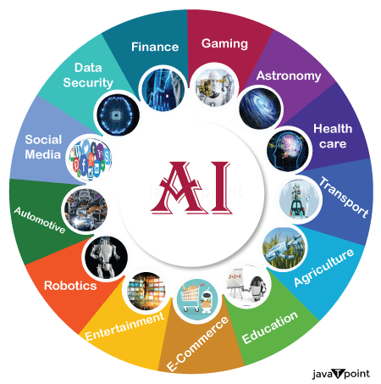
Where: AI Applications

Slide 9
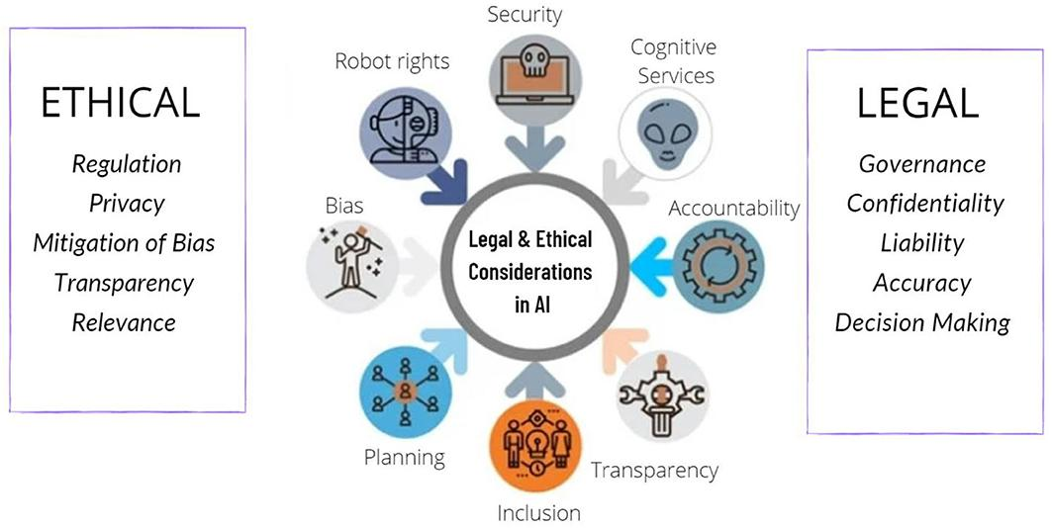
Ethical Considerations:
National Strategy for AI (released by NITI Aayog)
EU's General Data Protection Regulation (GDPR)
Ministry of Electronics and IT (MeitY)
OECD Principles on AI
ISO standards for AI

Slide 10
Cons of AI
Job Displacement
Lack of Human Emotions
Bias & Discrimination
High Cost of Development
Privacy Concerns
Overdependence on AI
Security Risks

Slide 11
ML Life cycle
Problem Definition
Data Collection
Data Preprocessing
Feature Engineering
Exploratory Data Analysis (EDA): univariate: histogram, bar chart
  Bivariate: scatter plot: num-num, heat map, pair plot….categorical-box plot
Model Building (Training)
Model Evaluation
Model Deployment & Monitoring

Slide 12
Problem Definition: domain knowledge
Data Collection: Databases, APIs,Files,Web scraping
Data Preprocessing:
  Handling missing values
  Removing duplicates
  Type conversions
  Encoding categorical variables
  Normalization/Standardization
Feature Engineering :
  Creating new features
  Feature selection
  Dimensionality reduction (PCA)
Exploratory Data Analysis (EDA) :
  Visualizations (histograms, boxplots, scatterplots)
  Summary statistics
  Correlation analysis
Model Building (Training)
Model Evaluation
  Classification: Accuracy, Precision, Recall, F1-score, ROC-AUC
  Regression: MSE, RMSE, R²
Model Deployment & Monitoring:
  REST API (Flask, FastAPI)
  Streamlit dashboard
  Cloud (AWS, GCP, Azure)

Slide 13
Career Opportunity
Machine Learning Engineer
Data Scientist
AI Researcher
Natural Language Processing (NLP) Engineer
Deep Learning Engineer
Computer Vision Engineer
Gen AI Engineer
AI Architect
AI Consultant

